Slide 1

教学辅助课件
牛津 七年级下

Slide 2
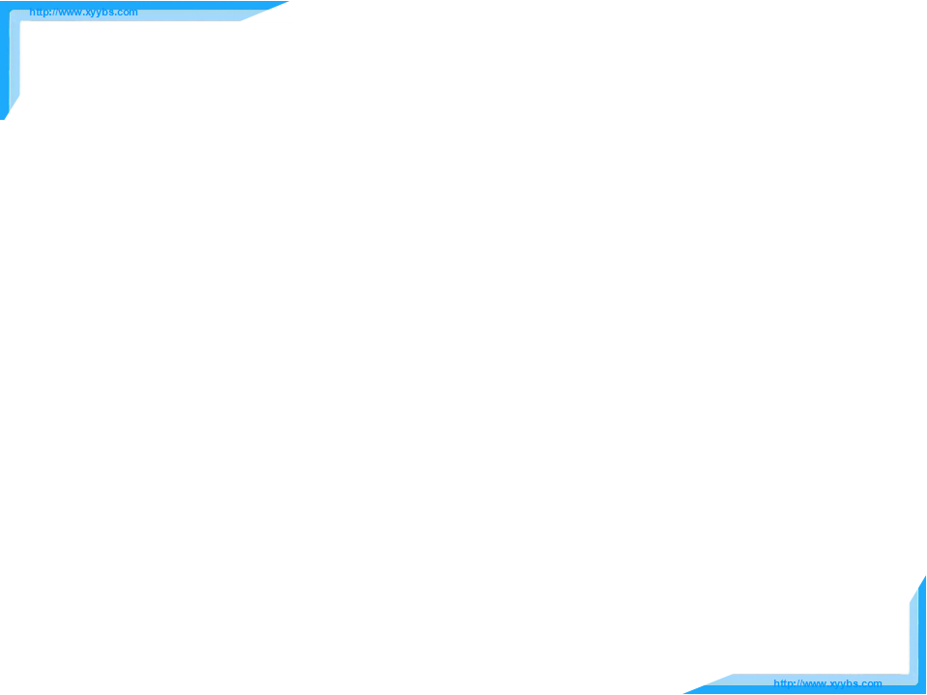

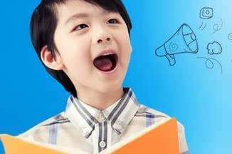

Study skills

Slide 3

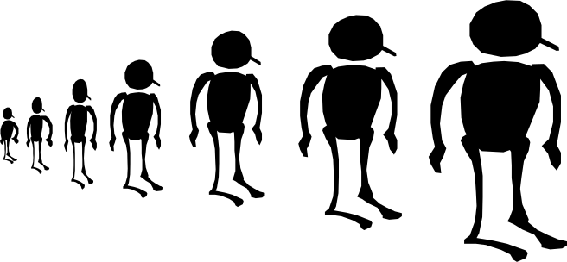
Objectives
To master the rules of tone in sentences
To be able to read sentences with correct tones

Slide 4




Listen to the tape and then read after it!
Read the following sentences!
1) Be careful.
2) It's a bad day, isn't it?
3) Glad to meet you, Allen.
4) I like it, but I can't afford it.
5) One, two, three, four, five.
6) That's a worthy book, isn't it?
7) Do you want noodles or rice?
8) How lovely the baby is!
9) Are you sure?
Pay attention to the falling tone and rising tone when you speak English.

Slide 5

Tone in statement
There is a path between the hills.
Pandas are cute.
Listen to the tape and mark a falling arrow( )
or a rising arrow( ) at the end of each sentence.
When we speak, we drop our tone at the end of a statement.

Slide 6
Tone in yes/no question
Are there any lions?
Is the zoo far away from our school?
When we ask a yes/no question, our tone usually rises at the end of the question.

Slide 7
Tone in wh-question
What can you see across the bridge?
How do I get there?
When we ask a wh- question, our tone usually falls at the end of the question.

Slide 8
In a sentence to show surprise
--The zoo is about three kilometres
away from our school.
--Three kilometres?
We make our tone rise at the end
of a sentence to show surprise.

Slide 9




小结
Falling tone
in statement
in wh-question
Rising tone
in yes/no question
in a sentence to show surprise

Slide 10

Millie: Hi, Sandy. Tomorrow is Saturday. Would
you like to go and see a film?
Sandy: Yes, I'd like to. Which cinema do you want
to go to ?
Millie: The one at Sunshine Shopping Mall.
Sandy: Sunshine Shopping Mall?
Millie: Sure. We can go shopping there too.
Sandy: Good idea. When shall we meet?
Millie: Is 2 p.m. OK?
Sandy: All right. See you then.
Read the conversation below. Put a falling arrow( ) or a rising arrow( ) at the end of each sentence. Then practise it with your parter.

Slide 11
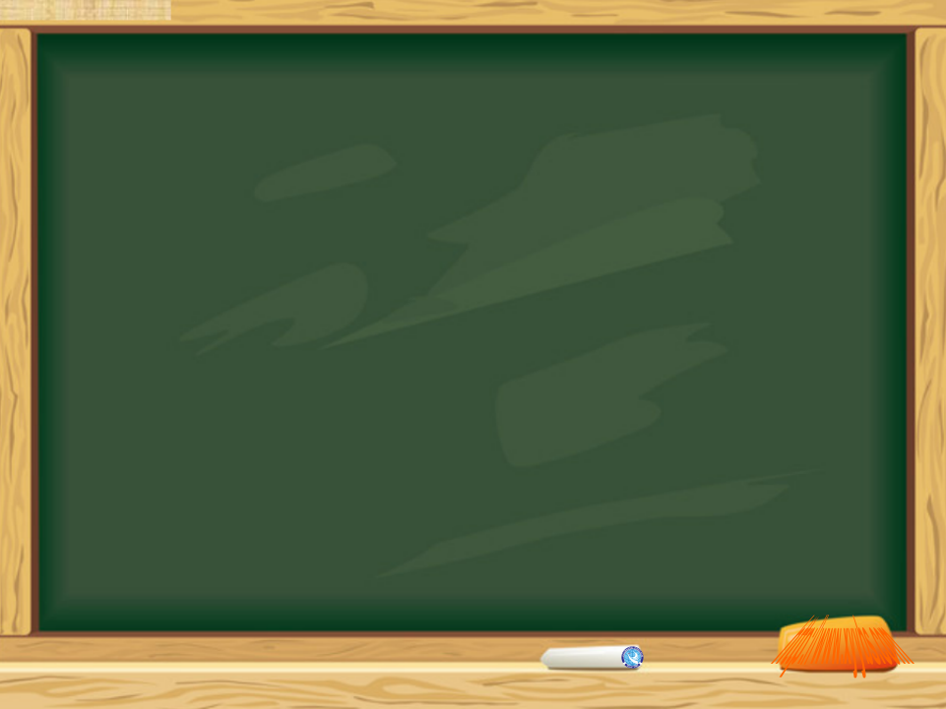

1. Read the sentences on page 51.
2. Preview Task on page 52.

